Slide 1
Sunnybrook Neuroimaging Summer School 2025
fMRI Module
Lecture #3:
How fMRI Can be Used in Neuroscience + Some Complications and Controversies
Emma Pineau

Slide 2
Lecture Overview
1. Task fMRI: Concepts and Examples
2. Resting state fMRI: Concepts and Examples
3. Additional Considerations and Complications

Slide 3
fMRI
Blood Oxygenation Level Dependent Imaging
We generate a series of sequential images
We measure changes in deoxyhaemoglobin content over time as a proxy for neuronal activity having occurred in a brain voxel

Slide 4
Task fMRI
Basic Assumption:
-brain shows different patterns of activity when it is performing a task versus at rest
GOAL:
-measure changes in BOLD signal to localize neuronal activity

Slide 5
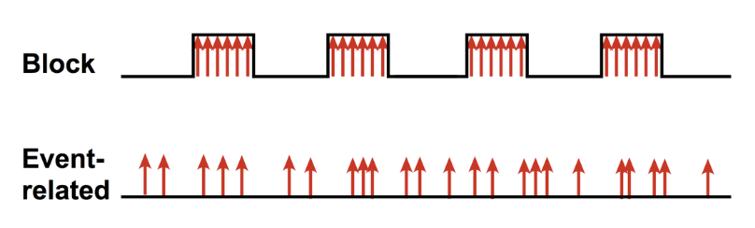
Task fMRI: Experimental Design
-block design: stimulus presented in a predictable ON/OFF pattern and we measure signal differences in ON versus OFF periods
-event-related design: stimulus presented as discrete isolated events in an unpredictable pattern
https://chunshan.github.io/MRI-QA/bold/fmri-paradigm-design.html

Slide 6
Experimental Design WHICH TO CHOSE?
-block design: signal averaged over longer ON and OFF blocks for improved SNR for shorter experiments and simple motor or sensory tasks
-event-related design: tasks with trial-by-trial variability, to assess correct versus incorrect trials (like in a memory task), when multiple tasks/stimulations are interspersed

Slide 7
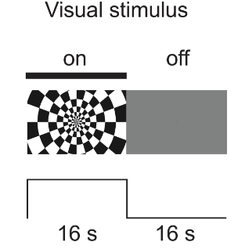
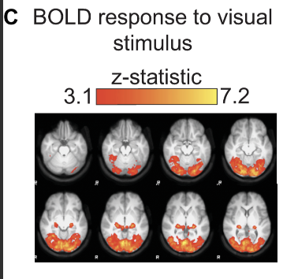
Block Design Example: Visual Cortex Mapping
Williams et al., PLOS Biology, 2023.

Slide 8
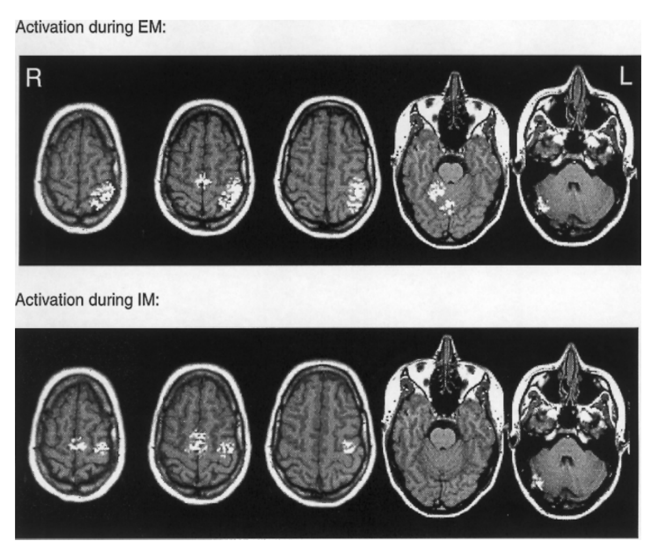
Event-Related Design Example: Motor Cortex Mapping
Brain was differentially activated in executed motion versus imagined motion
Some regions like the premotor cortex and supplementary motor area are equally actives under both conditions
Motor Cortex (M1) and somatosensory cortex (S1) showed more activation during executed motion
Lotz et al., Journal of Cognitive Neuroscience, 1999

Slide 9
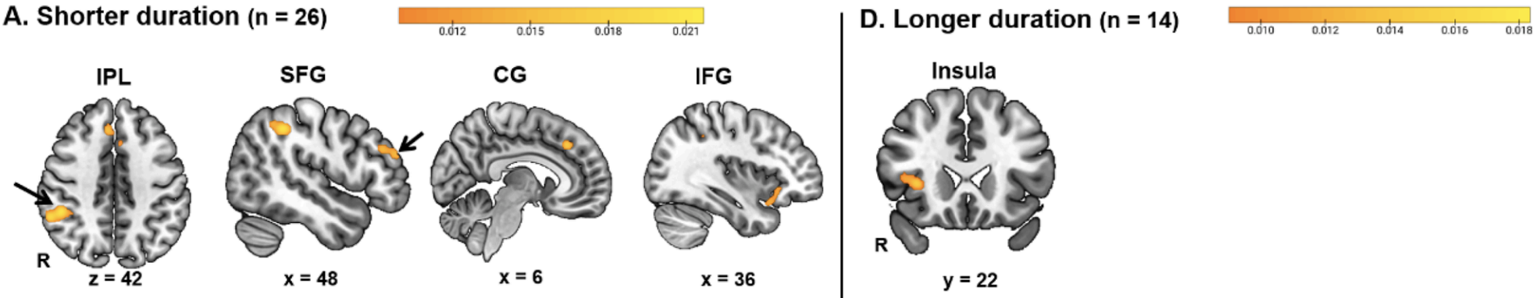
Example: fMRI as a sensitive measure of the brain-cognition axis
Recent meta-analysis comparing how the length of working memory training affects circuit plasticity
Different structures showed increased activation depending the length of the intervention
Zhang et al., Neuroimage, 2024.

Slide 10
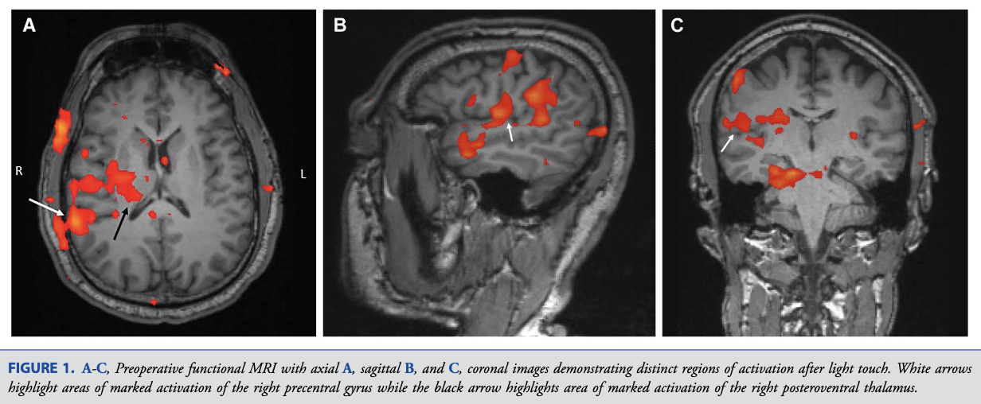
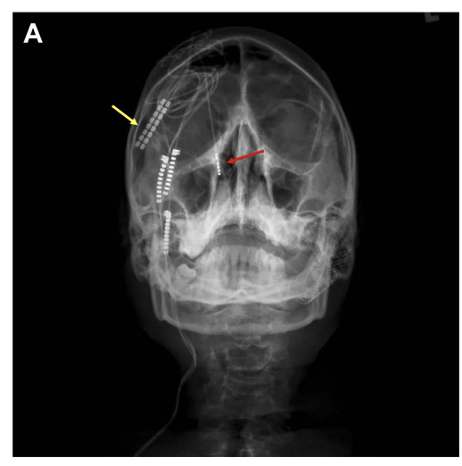
Example: Integration into Clinical Practice
fMRI guided placement of DBS leads to treat trigeminal neuralgia
Saway et al., Operative Neurosurgery, 2022.

Slide 11
Advantages
Able to localize regions of the brain whose activation is associated with specific functions
Hypothesis driven – clear research question from the choice of task/stimulation
Clinical utility in treatment planning and monitoring

Slide 12
Limitations
Requires compliance from patient/participant
Difficult in children and certain clinical populations (e.g., dementia patients)
Some subjects might use different strategies to perform the task (e.g., squinting rather than using active inhibition in switching tasks)

Slide 13
Resting State fMRI
Basic Assumptions:
The brain is always active, even “at rest”
The BOLD signal is constantly fluctuating in the absence of a task
Goal:
Find patterns in the signal fluctuations of distant brain voxels

Slide 14
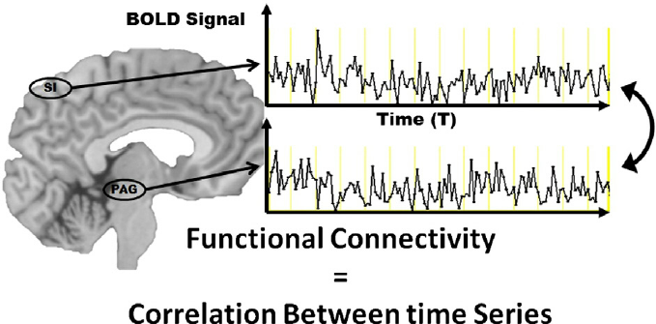
Functional Connectivity
A measure of the statistical interdependence of disparate voxels/ROIs timeseries
Simply: the correlation between timeseries
This doesn’t imply “wiring together” as it may be mediated by an intermediate or common input
the opposite is generally true: “if they wire together they fire together”
Gay et al., Journal of Manipulative and Physiological Therapeutics, 2014

Slide 15
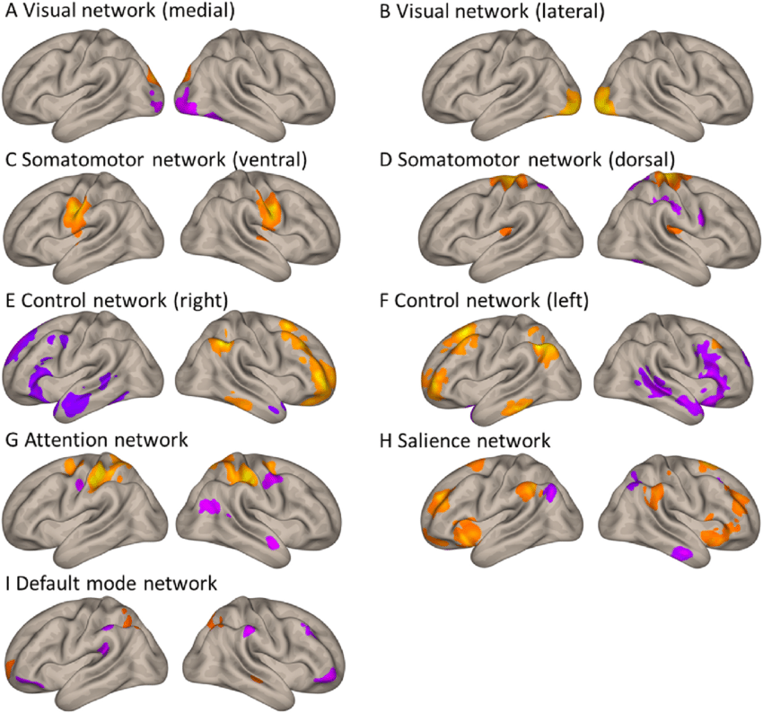
Brain Networks
Brain networks: groups of regions that show high functional connectivity over time
Networks are often large and distributed
Networks can be associated with specific functions (e.g., attention network, memory network etc.)
Andin et al., Neuropsychologia, 2022

Slide 16
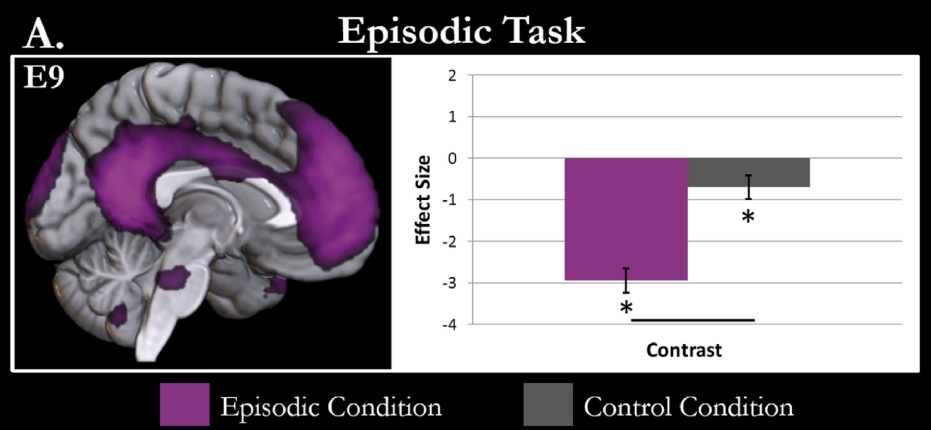
Example: The Default Mode Network
Brain network that is anti-correlated to task performance
Jackson et al., Cortex, 2023

Slide 17
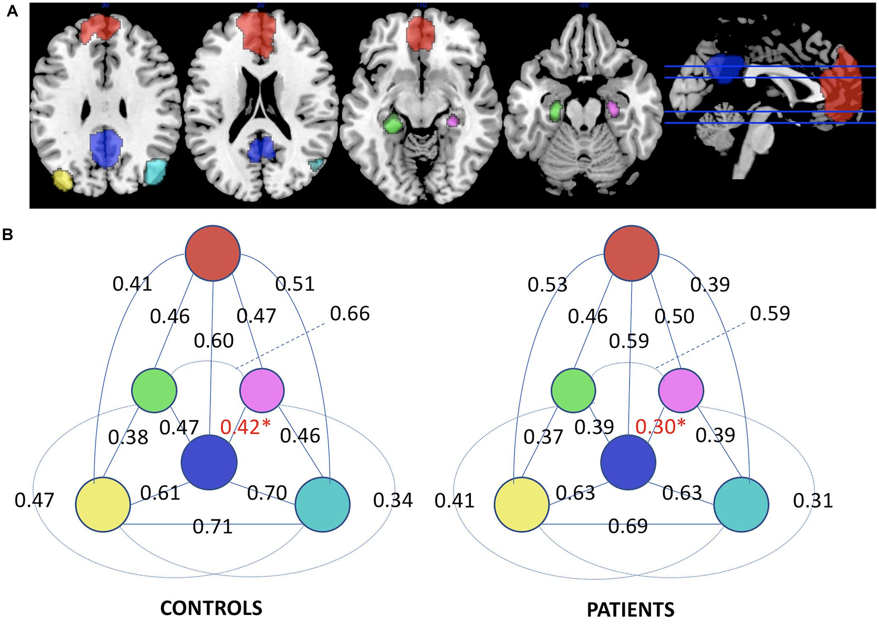
Example: fMRI Detectable DMN Alterations in Alzheimer’s Disease
In some conditions, like Alzheimer’s Disease, there is alterations in the “usual” functional connectivity of the DMN
Perhaps changing DMN connectivity is a factor in cognitive impairment
Greider et al., Frontiers in Neuroscience, 2018.

Slide 18
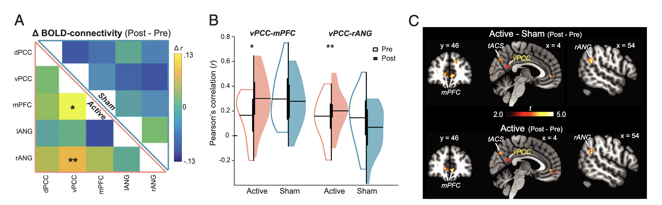
Example: fMRI to Monitor DMN Modulation
Transcranial alternating current stimulation can modify the DMN connectivity strength
Clancy et al., PNAS, 2022.

Slide 19
Advantages
Able to investigate how the brain communicates as a whole
Model free so more exploratory approach
Emerging clinical utility in treatment planning and monitoring

Slide 20
Limitations
More susceptible to motion and physiological artifacts
Challenges in reliability and reproducibility
Patient compliance
Inter- and intra-individual variability??

Slide 21
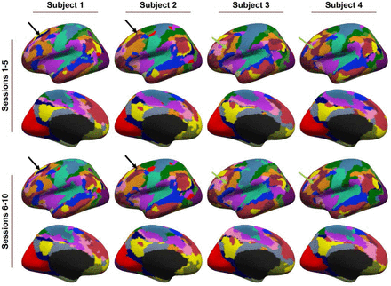
Inter vs Intra Individual Variability
Changes in state: wakefulness, attention, stress levels will always lead to intraindividual variability
Changes in anatomy, genetics, presence or absence of pathology will always lead to interindividual variability

Slide 22
How to Appropriately Design a Study
Intra-individual differences may obscure pre/post intervention effects
Inter-individual differences may obscure real group differences
Is the solution collecting more data per subject to average out intra- effects?
Is the solution increasing sample size to average out inter- effects?
Pre-Treatment
tACS
Post-Treatment
Pre-Treatment
Sham
Post-Treatment

Slide 23
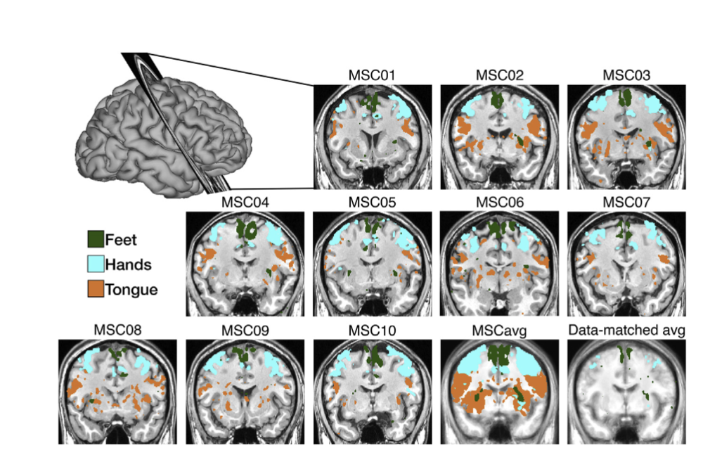
How Accurate is an Average Brain Map on a Person-by-Person Basis
Treatment planning based on the average functional map would target different networks across patients!
Gorden et al., Neuron, 2017.

Slide 24
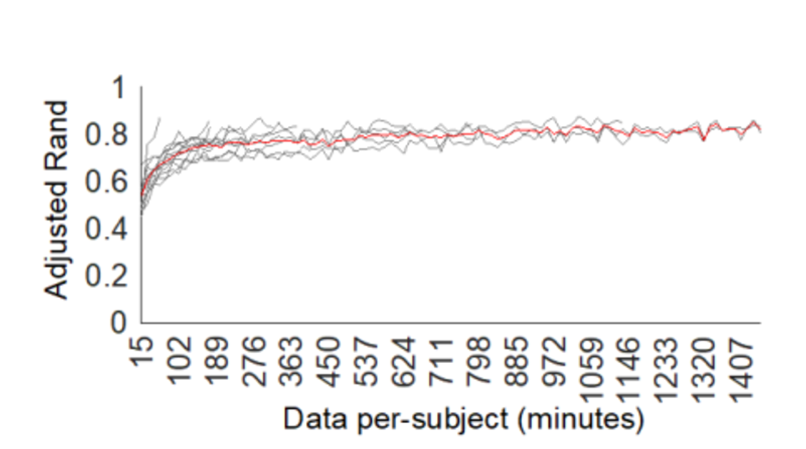
How Much Data is Needed for Precision fMRI?
Even 30 minutes of resting state data acquisition adds complexity to an experimental design as compared to a “one-size-fits-all” therapeutic approach!
Lynch et al., Cell Reports, 2020 and Neuron, 2022.

Slide 25
Further Reading (Available Through UofT Online Library)
Introduction to Functional Magnetic Resonance Imaging
Richard Buxton, 2009
MIT Press: fMRI
Peter Bandettini, 2020
Chapter 8: Twenty-Six Controversies and Challenges

